Slide 1
Notes from PAG XXVI
Yury V Bukhman. Presented at BioComP meeting 22 Jan 2018. Modified 12 Mar 2018.

Slide 2
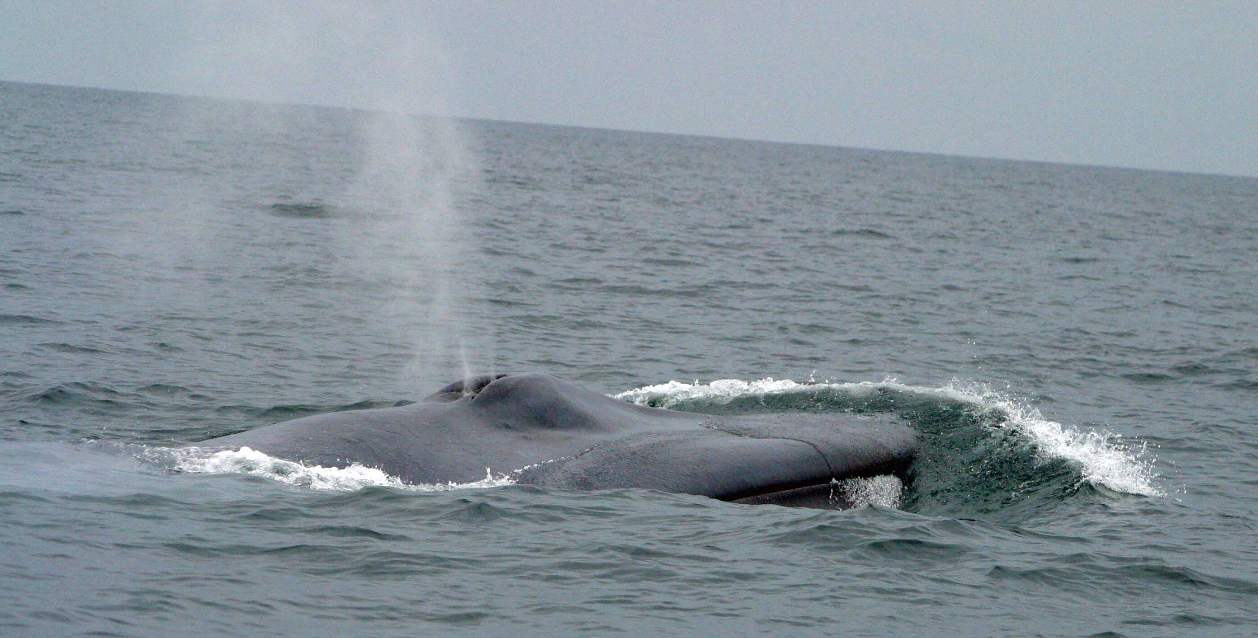
Disclaimers
Many parallel sessions and only one me
I was primarily interested in mammalian genomics
I was shopping for software I could use for my blue whale genome project

Slide 3
Overview
Selected key notes
How to build a genome
What to do with a finished genome
Transcriptome

Slide 4
Selected key notes
Melissa Wilson Sayres: Sex chromosomes
  Arose independently multiple times in various plant and animal lineages
  Inversions in sex chromosomes prevent recombination
  “Evolutionary strata”: regions of a sex chromosome that stopped recombining at different times in the past
Gloria Coruzzi: transient binding of TFs and cascades of gene expression effects
  80% of TF-regulated genes are not bound to TFs → missed by ChIP-seq. One example – BRCA1 gene
  “Hit and run” transcription regulation. A TF is like a bee, hopping from flower to flower.
  TF attracts ”cis elements”. TF goes away but the partner cis elements remain in place to drive transcription.
  DAP-seq is better than ChIP-seq?
Jay Shendure: combinatorial labeling of single cells using CRISPR. Used for:
  massively parallel assays (sc-ATAC-seq paper)
  tracing cell lineage (GESTALT paper).

Slide 5
How to build a genome

Slide 6
How to build a genome
Sequence the DNA
Assemble contigs
QC and visualize
Add long-range data
Build scaffolds
Annotate

Slide 7
Genome building workflow
Long reads (PacBio)
Short reads (Illumina)
String Graph Assembly (Falcon, HGAP, Canu)
Hybrid Assembly (DBG2OLC, MaSuRCA)
De Bruijn Graph Assembly (Platanus, SOAPdenovo)
Genetic maps
Phasing (Falcon-unzip, HapCut)
Contigs
Polishing (Arrow, Racon, Pilon)
Scaffolding
Nanopore?
Hi-C
Optical maps
Synthetic long reads (10X)
Mate pair reads
Scaffolds
Gap filling (PBJelly)
Annotation (MAKER, BRAKER, …)
RNA-seq
IsoSeq
Genome
Nature paper
Molecular evolution analyses

Slide 8
Genome sequencing technologies
PacBio rules (at least for now)
Illumina
  Conventional short reads (PE + mate pair) based de-novo assembly is on its way out
  Some projects use synthetic long reads (10X Genomics)
  Hybrid assembly is rare
  Short reads are widely used for genome polishing and genotyping
Nanopore has not been widely used yet

Slide 9
Genome assembly, QC, and Visualization

Slide 10
Assembly Software
Commonly used long read assemblers are Falcon and Canu
Commonly used short read assemblers are SOAPdenovo and Platanus
Flye – a new assembler for ONT. Resolves repeats.
MaSuRCA – hybrid assembler for combination of short (Illumina) and long reads (Sanger, 454, PacBio and Nanopore)
Minimap + miniasm – “ultrafast” assembly of noisy long reads

Slide 11
PacBio software
Falcon & Falcon-unzip binaries
HGAP4 has Falcon under the hood
SMRTLink
  submit jobs using web browser or API
  Can use tools without the API
Manage releases and dependencies
  SMRTLink comes out in releases tied to wet lab technology updates, e.g. new chemistries. It provides pre-built binaries
  Pitchfork has access to all releases and can install SMRTtools a-la-carte. Tools need to be built on the user’s system

Slide 12
Trio Binning: Sergey Koren, NHGRI
Assembly has bubbles
Falcon does not know which haplotype comes from which parent
Trio binning assigns parental alleles
Input: long reads for an individual + short reads for both parents (just one parent may also work)
Classify K-mers as coming from one parent or the other
Assign haplotigs accordingly

Slide 13
Assembly QC and Visualization Software
BUSCO and CEGMA – commonly used to assess and assembly’s ability to predict genes.
  BUSCO & CEGMA scores are highly correlated.
  Some use BUSCO results to train gene predictors for genome annotation step
QUAST – incorporates several tools and databases
Bandage: assembly graph visualization tool

Slide 14
Long range data & Scaffolding

Slide 15
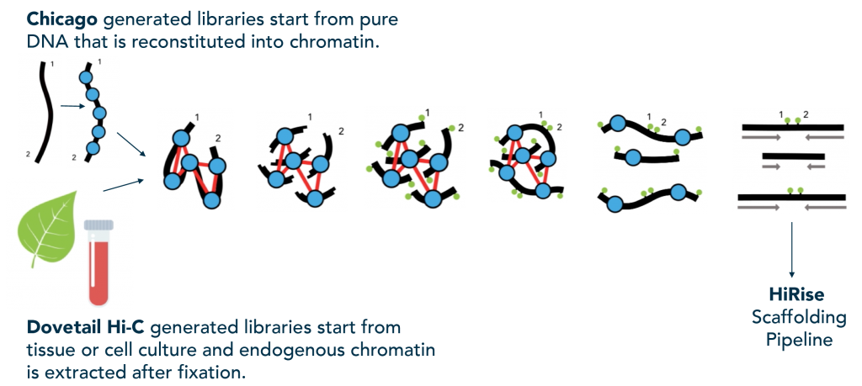
Hi-C and Chicago
Dovetail Genomics
Commercial providers: Dovetail Genomics, Phase Genomics, Arima Genomics

Slide 16
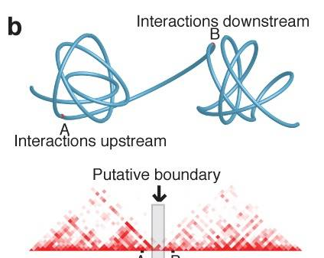
Topologically Associated Domains
Dixon, Jesse R., Siddarth Selvaraj, Feng Yue, Audrey Kim, Yan Li, Yin Shen, Ming Hu, Jun S. Liu, and Bing Ren. “Topological Domains in Mammalian Genomes Identified by Analysis of Chromatin Interactions.”Nature485, no. 7398 (April 11, 2012): 376–80.https://doi.org/10.1038/nature11082.
TADs are conserved between species, e.g. human/mouse/cattle

Slide 17
The Many Uses of Hi-C
Assemble and scaffold genomes.
  PGA = Proximity-Guided Assembly
Study chromosomal 3D structure
Separate out individual genomes in metagenomics datasets

Slide 18
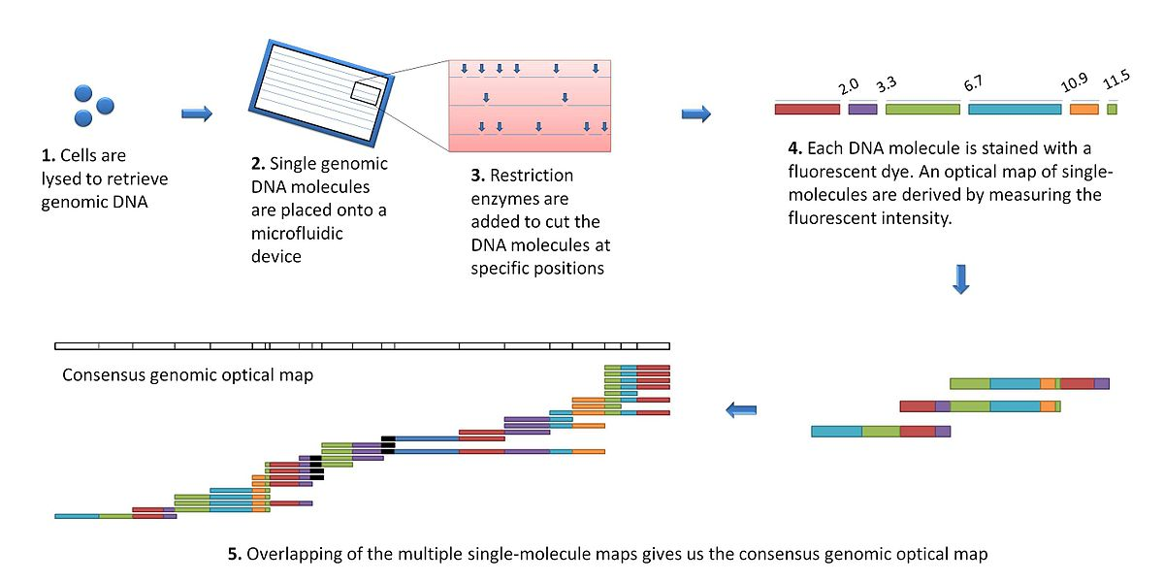
Optical Maps
Figure by Fong Chun Chan and Kendric Wang - Own work, CC BY 3.0, https://commons.wikimedia.org/w/index.php?curid=9628643
Commercial provider: Bionano Genomics (BNG)
New DLS chemistry does not cut or nick DNA → 50X longer maps (from 100 kbp to > 1 Mbp

Slide 19
Optical map software
Bionano software: free downloads
XMView: visualize the alignment of assembled contigs against optical maps + (optionally) a genetic map. Helps discover chimeric contigs. Alternative to Bionano IrysView(?)

Slide 20
Synthetic long reads
Company: 10X Genomics
Build long reads (100 kbp) from short reads (Illumina) linked to each other
Used for genome assembly and phasing: publications
Other applications: massively parallel sc-RNA-seq, immunology

Slide 21
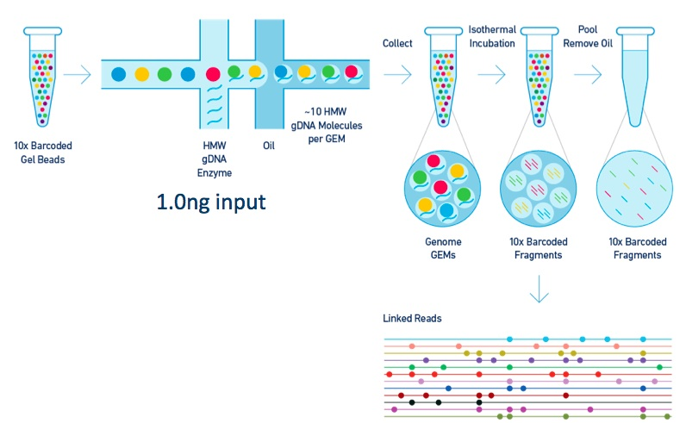
10X Genomics Technology
Partition HMW gDNA or cDNA
  droplets, i.e. “GEMs”, i.e. Gel beads in emulsion
  One gel bead per droplet
  Unique identifying tags attached to each bead
  ~10 DNA molecules per GEM.
Fragment/label/amplify DNA in each droplet
Pool and sequence on an Illumina machine
  Each short read retains a barcode that identifies the droplet it came from
Assemble labeled short reads into ~100 kb synthetic long reads
  Reads from each droplet form a few clusters that correspond to distinct original HMW DNA molecules.
Figure source: https://wheaton5.github.io/projects/tenx

Slide 22
(Some) Mammalian Genomes Presented at PAG XXVI
Presenter | Species | Sequencing platforms | Contig N50, Mb | Long range data | Scaffold N50 | Bioinformatics workflow
Heather M. Holl | Dromedary Camel | 74X Illumina + 15X PacBio | 2.3 | 30X of 10X Chromium |  | Assemble Illumina reads => Hybrid assembly with PacBio => Scaffold with 10X => Polish with Pilon
Lloyd Low | Water Buffalo | 69X PacBio | 19 | 22X Chicago + 53X Hi-C | 117 | Falcon + unzip => polish with BLASR/arrow => scaffold with Chicago & Hi-C
Zev N. Kronenberg | Chimp and orangutan | PacBio | 11 | Bionano (optical map) + HiC |  | Falcon => scaffold with Bionano and Hi-C
Moore, Stephen | Australian Brahman | 60-70X PacBio | NG50 = 10 | Will do Chicago, Hi-C |  | Will use short reads for polishing
Gonzalo Rincon | Holstein Bull | 33X PacBio + 109X Illumina (PE + 3 kb mate pairs) | 2.9 | 215X Dovetail Chicago + linkage map + optical map | 104 | Falcon assembly => Arrow polishing => Scaffolding with Dovetail, Mate pairs, Optical Map, Genetic map => Gap closing => Pilon polishing
Kim C. Worley | Rambouillet Sheep | 200 Gb PacBio (~70X?) | 2.6 | Hi-C (Phase Genomics?) |  | Celera Assembler => Arrow polish => scaffolding: Hi-C PGA* =>PBJelly & misFinder gap filling and correction => Pilon polish
Kisun Pokharel | Reindeer | 7 Illumina libs from 170 bp to 20 kbp | 0.048 | Illumina mate pair reads up to 20 kb | 0.5 | SOAPdenovo assembler
Yuan Yin | Black Muntjac Deer | PacBio | 1.3 | Hi-C | 552 | Falcon assembly. Polishing with long reads (minimap) and short reads (Pilon)
Ruijun Wang | Mouflon (a wild sheep) | ~220X Illumina PE & mate pair | 0.11 | Illumina mate pair reads 2-20 kb | 10.4 | Platanus assembler
Notes:
*PGA = Proximity-Guided Assembly

Slide 23
Scaffolding, phasing, and gap filling software
Dovetail, Bionano, and 10X all provide custom software with their instruments and services
HapCUT2 – “robust and accurate haplotype assembly for diverse sequencing technologies”. Used by several projects presented at PAG XXVI
PBJelly - gap filling
misFinder – “Identify mis-assemblies in an unbiased manner using reference and paired-end reads”
WhatsHap - software for phasing genomic variants using DNA sequencing reads, also called read-based phasing or haplotype assembly

Slide 24
Genome annotation

Slide 25
Genome features
Protein coding genes
Pseudogenes
ncRNA
Regulatory elements
Repeats
Transposable elements
Endogenous viruses
UCEs and CNEs
…

Slide 26
Genome annotation software

Slide 27
Tools for genome annotation: protein-coding genes
Ab-initio gene prediction
  GeneMark: GeneMark-ES (unsupervised learning) and GeneMark-ET (“semi-supervised”, uses RNA-Seq reads to improve training)
  AUGUSTUS: needs a training set of genes [from a closely related species]
Homology based gene prediction
  GeMoMa - GeneModelMapper (GeMoMa) is a homology-based gene prediction program that can also incorporate RNA-seq data
cDNA and EST based gene identification
  MAKER, GeneMark-ET, …
Pipelines incorporating multiple tools
  MAKER – genome annotation pipeline, a GMOD project. “identifies repeats, aligns ESTs and proteins to a genome, produces ab-initio gene predictions and automatically synthesizes these data into gene annotations having evidence-based quality values”
  BRAKER - a tool for fully automated genome annotation with GeneMark-ET and AUGUSTUS. Can use RNA-seq and a protein database from a related species
  GenSAS – a web server for genome annotation. User-friendly.

Slide 28
More tools for genome annotation
DeFusion: break up spurious gene fusions created by MAKER. Apparently found 540 such fusions in a tree genome. Alpha version on GitHub.
PiRATE – annotate TEs. Encapsulates 12 previously developed tools

Slide 29
GMOD: Generic [Model] Organism Database
http://gmod.org/wiki/Main_Page
Used by a number of genome projects
Could not drop “Model” from the name
Chado relational database schema
JBrowse genome browser
Apollo genome browser and manual annotation tool
Tripal and elastic search
Many other tools, e.g. MAKER, Galaxy, …

Slide 30
NCGAS – National Center for Genome Analysis Support
Hosted by Indiana U.
Will support any US-based [academic] genome researcher
Can help set up a genome project web site
Can “pop up” an instance of JBrowse on Jetstream cloud: no need for manual set-up

Slide 31
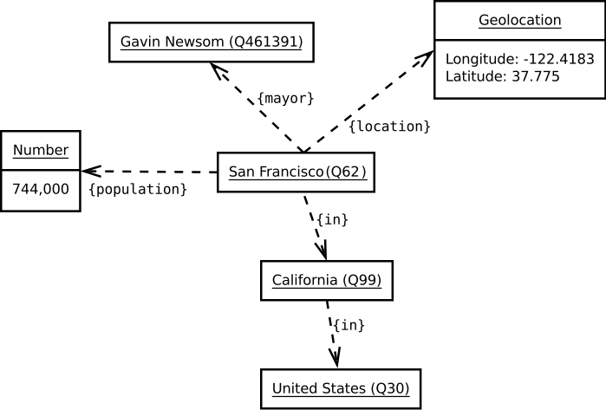
Wikidata: a giant graph of knowledge

Slide 32
Wikidata Features
SparQL language: query Wikidata and other online resources, e.g. Wikipathways
Wikidataintegrator retrieves data from online databases
Can build custom apps for specific communities, e.g. Wikigenome
All data posted to Wikidata are publicly available. Apps like Wikigenome can support private data

Slide 33
Some interesting genes

Slide 34
Bovine growth genes
Mahdi Saatchi, ARRDC3, PLAG1 and ERGIC1 Genes Are Remarkably Associated with Pre- and Post-Natal Growth in Beef Cattle
  ~12K animals of 3 different breeds
  Measured birth, weaning and yearling weights
  Assayed SNPs in previously found genome regions
  SNPs in NCAPG, ARRDC3, PLAG1, and ERGIC1 were significantly associated with weight. Their effects on weight were 6-7 lb. (of ~90 lb.) at birth, 42-55 lb. (of ~1,000 lb.) at yearling.
PLAG1 was introgressed from Bos taurus into Bos indicus in Australia

Slide 35
Long non-coding RNA
FAANG: “High depth of RNA-seq identified 9,393 long non-coding RNAs in chicken, 7,235 in cattle, and 14,428 in pig.”
Tissue-specific translation
FR-Agencode also detected large numbers of lncRNA
What are they for?

Slide 36
Major genome annotation projects and consortia
Projects that are relevant to mammalian genomics
VGP already mentioned: see above

Slide 37
NCBI & EBI/ENSEMBL
30 – 55% disagreement between NCBI and ENSEMBL
Manual annotation: GENCODE/HAVANA, annotation guidelines
CCDS: Consensus CDS for human and mouse

Slide 38
Genomes at NCBI
435 eukaryotic genomes annotated
NCBI runs its own genome annotation workflow. Results are in RefSeq.
  Screens for contamination
  Adds a mitochondrial chromosome if need be
  Annotates human orthologs, additional protein coding genes, pseudogenes, ncRNA
  Authors can submit their own annotations, e.g. as GFF files
  Corrects assembly errors, e.g. corrected frame shifts in 2,500 pig genes
Assembly can have multiple versions. History documents improvements
Support for diploid assembly and for haploid with multiple alternative loci
~2/3 overlap with ENSEMBL annotations according to some. 30-55% disagreement according to others

Slide 39
GENCODE
High-quality reference annotations of human and mouse genomes
  Includes manual annotation efforts, e.g. HAVANA
https://www.gencodegenes.org/about.html
Funding: NHGRI ENCODE grant with additional funding from the Wellcome Trust

Slide 40
Vertebrate Gene Nomenclature Committee (VGNC)
Responsible for assigning standardized names to genes in vertebrate species that currently lack a nomenclature committee
Automated transfer of gene annotations from human (HGNC) for genes where the same orthologs are predicted by four different resources
The current species for VGNC naming are chimpanzee, horse, cow and dog
This naming process will be extended to other species in due course
Our criteria for choosing further vertebrate species are the quality of the genome assembly and annotation, the perceived value as a research organism and the level of support from the scientific community.

Slide 41
FAANG workshop notes

Slide 42
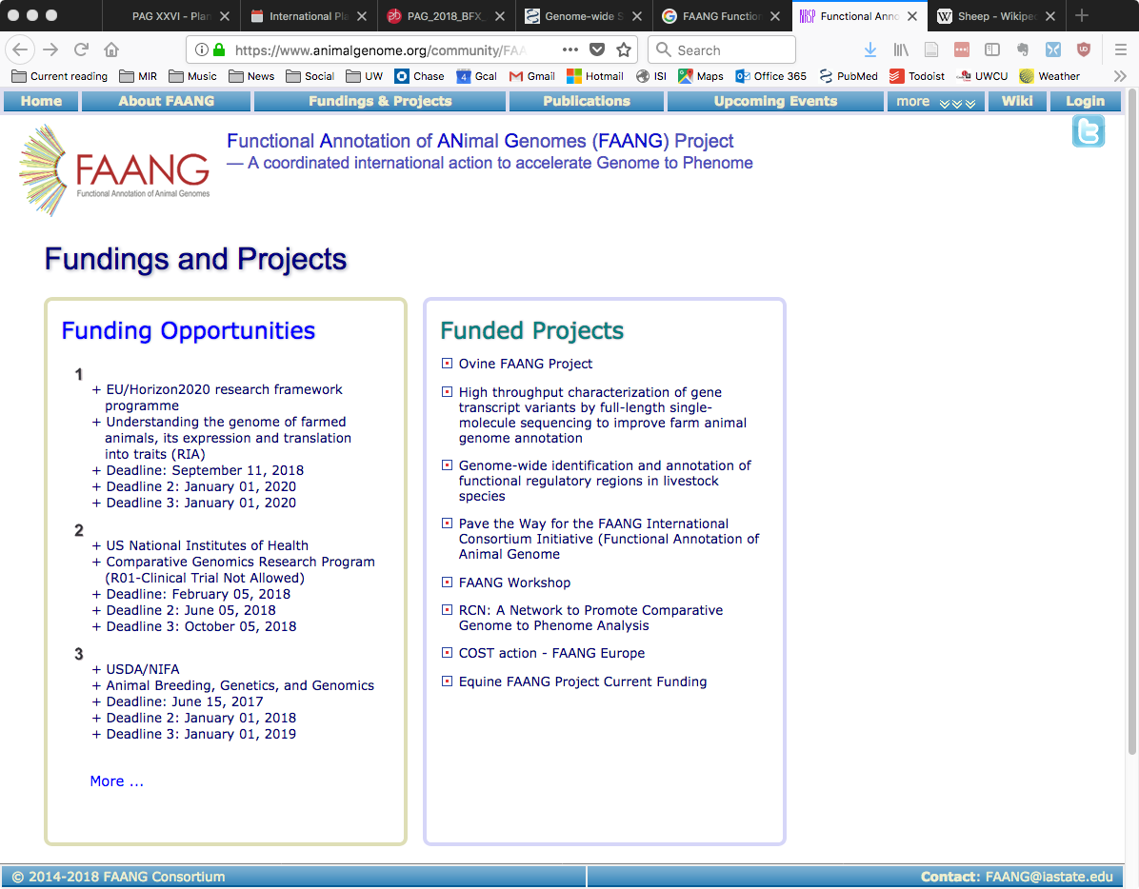
Functional Annotation of Animal Genomes (FAANG)
International consortium
Funds projects
Develops and shares assay protocols
Develops and shares data analysis workflows
Hosts and disseminates data on a data portal

Slide 43
Genome Wide Identification and Annotation of Functional Regulatory Regions in Livestock Species
2 male replicates of each species, e.g. chicken, cattle and pig
Multiple assays, e.g. strand-oriented RNA-seq, DNase-seq, ATAC-seq, histone methylation assays, CAGE, CTCF etc.
Multiple tissues, e.g. adipose, cerebellum, cortex, hypothalamus, liver, lung, muscle, and spleen

Slide 44
FR-Agencode
French project similar to FAANG
two males and two females per species (pig, cattle, goat, chicken)
strand-oriented RNA-seq, ATAC-seq, Hi-C
liver and two T-cell types (CD3+CD4+, CD3+CD8+) sorted from blood (mammals) or spleen (chicken)
“thousands of novel transcripts, extensions of annotated protein-coding genes and new lncRNAs”

Slide 45
FAANG Summary
Currently focused on farm animals, but can be extended to all animals, in principle
Multiple measurements in 2 animals of the same species (or 2 of each sex)
  Multiple tissues an/or cell types
  Multiple assays
Sharing of experimental protocols and bioinformatics workflows
Need more bioinformaticians and planning to provide training opportunities
Pre-publication data sharing with a rule/understanding that the data producer must be allowed to publish first
Criticism: 2 animals cannot adequately represent a species

Slide 46
What to do with a finished genome

Slide 47
What to do with a genome?
Characterize a population: use Illumina + low coverage PacBio, e.g. 10X
Look for genetic markers associated with phenotypes, e.g. color in camels, breed differences in cattle
  Mike Schatz’s talk: Reference-guided assemblies → Individualized diploid genomes: AlleleSeq, CrossStitch etc.
Build phylogenetic tree with related species and assess gene family gain/loss at different nodes
  CAFÉ
  Mammalian synteny network: paper, data. Includes 3 dolphins, sperm whale, and common minke whale

Slide 48
Tools for evolutionary and comparative genomics
F_{ST} – fixation index, “measure of population differentiation due to genetic structure”
smartie-sv – tool for discovering SVs against a reference genome. [Finds SVs of up to 60 kb]. Was used by Z. N. Kronenberg to compare great apes and human genomes
CAFÉ – Computational Analysis of gene Family Evolution. Compare genomes of related species to detect gene duplication and loss. “Robust in the face of less-than-ideal [i.e. fragmented and incomplete] assemblies”
  Inputs: a phylogenetic tree + a data file containing gene family sizes in species
  To get gene family sizes: all vs. all BLAST for a set of species → clustering

Slide 49
Tools for genetic manipulation
Design CRISPR-Cas9 guide RNA: GGGenome and CRISPRdirect

Slide 50
Transcriptome

Slide 51
Iso-Seq
PacBio RNA-seq
The reads are long enough to capture entire transcripts
Example: 7K genes → 17K transcripts
Third party software: SQANTI & TAPPAS

Slide 52
Whole Transcriptome Termini Site Sequencing (WTTS-Seq)
Amplify and quantify 3’ ends of [eukaryotic] transcripts
Special “poly-A anchored” primers
Detect and quantify alternative transcript termini
Cheaper and less noisy than RNA-seq?
Presented by Zhihua Jiang, Washington State U.
Related paper:
Zhou, Xiang, Rui Li, Jennifer J. Michal, Xiao-Lin Wu, Zhongzhen Liu, Hui Zhao, Yin Xia, et al. “Accurate Profiling of Gene Expression and Alternative Polyadenylation with Whole Transcriptome Termini Site Sequencing (WTTS-Seq).” Genetics 203, no. 2 (June 1, 2016): 683–97. https://doi.org/10.1534/genetics.116.188508.

Slide 53
Whole transcriptome start site sequencing (WTSS-seq)
Sequence the 5’-ends of transcripts
Presented by Zhihua Jiang, Washington State U.
Another [older] technique: CAGE – Cap analysis gene expression

Slide 54
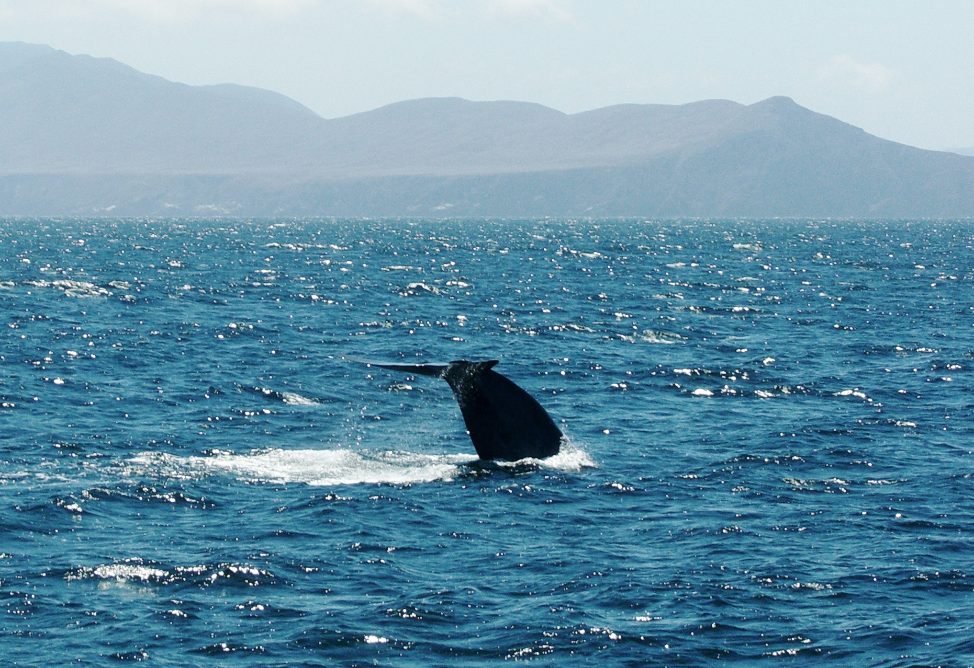
Thank you!

